Slide 1














Image Denoising Application using MATLAB
Presented by Usman Abbasi and Yahya Arshad

Slide 2
Introduction
Noise in images refers to random variations in brightness or color.
It can come from camera sensor limitations, poor lighting, transmission errors, or electronic interference.
Noise affects images by reducing quality and clarity, blurring edges and fine details, and making it harder to extract meaningful information.
To remove noise, various denoising techniques and filters are used to improve image quality.
To help understand the effects of different types of noise and filtering techniques, we have created an image denoising app using the MATLAB app designer.

Slide 3
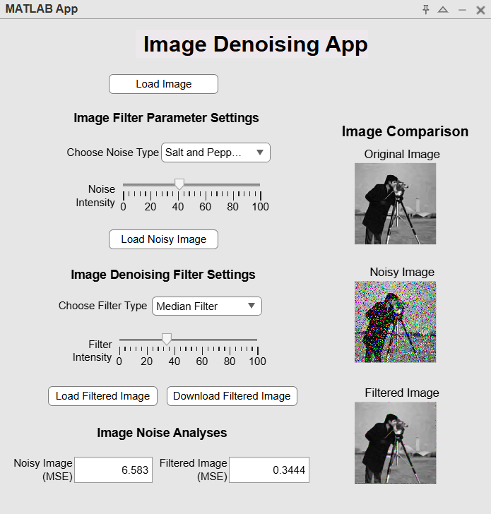
App Interface
The app provides an intuitive and interactive user interface.
Users can load an image, add adjustable noise, apply filters with customizable levels, and view the effects on images in real-time.
Noise levels in the noisy and filtered images, relative to the original, can be analyzed using Mean Squared Error (MSE).
Fig1. Application Interface

Slide 4
App Features and Workflow
Load Image
Choose Noise (ex: Gaussian, Speckle, Salt & Pepper)
The app allows users to choose from a variety of different noises and filters.
It enables users to vary the intensity of both noises and filters to get the desired effect.
The app also allows users to load noisy images and denoise them without adding more noise.
It lets users view the effect of noises and filters in real time, and analyze which filter type works best for each noise.
The app has a download feature which enables users to download their filtered images
Set Noise Intensity
Load Noisy Image
Choose Filter Type (Gaussian, Median, Wiener and etc)
Set Filter Intensity
Load Filtered Image and Download it
Fig2. Application Workflow

Slide 5
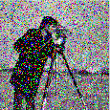
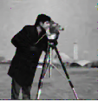
Results
The application includes 8 different filters, which can be used to denoise a variety of noise images.
For Gaussian Noise: Gaussian and Wiener Filter
For Salt & Pepper Noise: Median and Rank Order Filter
For Speckle Noise: Average Filter and Wavelet Transform
Hybrid Filters can help provide a balanced nose reduction
To achieve a good result, users can keep adjusting the intensity of the noise to achieve the desired result
Fig3. Noisy and Clean Image

Slide 6
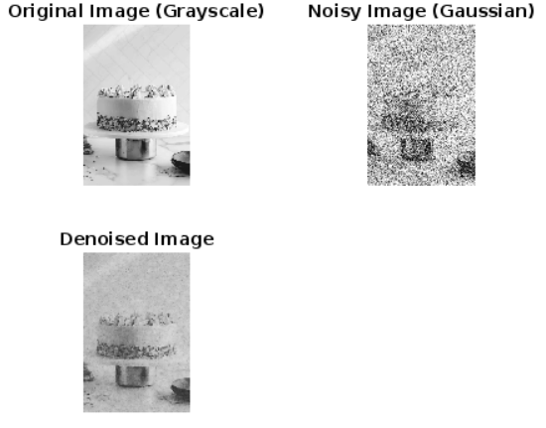

Additional Work
We also deployed a pre-trained deep learning model on MATLAB called ‘DnCNN’.
DnCNN is trained on a variety of noisy grey scale images, but works best on images with gaussian noise.
DnCNN demonstrates the importance of Neural Networks in Image Denoising Application.
Neural Networks can learn complex features, adapt to different noise levels and have a lot of potential in such applications
Fig4. DnCNN Image Denoising

Slide 7
Conclusion
We were able to successfully design and implement a MATLAB-based denoising app.
The tool can be used as both a denoising application and a educational tool.
We were able to incorporate filters in our app which were able to successfully filter out gaussian, salt & pepper and speckle noise.
We were also able to work on pre-trained models like DnCNN.
Future enhancements may include exploring various more filters such as adaptive filter, PDE-based filters, deep neural networks, total variation based filters and etc.

Slide 8
References
[1] L. Fan, F. Zhang, H. Fan, and C. Zhang, "Brief review of image denoising techniques," Visual Comput. Ind., Biomed. Art, vol. 2, no. 1, p. 7, Jul. 2019.
[2] C. Saxena and D. Kourav, "Noises and image denoising techniques: A brief survey," Int. J. Emerg. Technol. Adv. Eng., vol. 4, no. 3, pp. 878-885, Mar. 2014.
[3] M. Mafi, H. Martin, M. Cabrerizo, J. Andrian, A. Barreto, and M. Adjouadi, "A comprehensive survey on impulse and Gaussian denoising filters for digital images," Signal Process., vol. 157, pp. 236-260, Apr. 2019.
[4] K. Zhang, W. Zuo, Y. Chen, D. Meng, and L. Zhang, "Beyond a gaussian denoiser: Residual learning of deep CNN for image denoising," IEEE Trans. Image Process., vol. 26, no. 7, pp. 3142-3155, Jul. 2017.
[5] V. Murali and P. V. Sudeep, "Image denoising using DnCNN: An exploration study," in Advances in Communication Systems and Networks: Select Proceedings of ComNet 2019, pp. 847-859, Springer Singapore, 2020.

Slide 9
Thank you!

